Slide 1
Learning with Trees

Slide 2
Using Decision Trees
As a student it can be difficult to decide what to do in the evening. There are four things that you actually quite enjoy doing, or have to do: going to the pub, watching TV, going to a party, or even (gasp) studying. The choice is sometimes made for you—if you have an assignment due the next day, then you need to study, if you are feeling lazy then the pub isn’t for you, and if there isn’t a party then you can’t go to it. You are looking for a nice algorithm that will let you decide what to do each evening without having to think about it every night.
3 features: energy level, deadline, there is a party or not.

Slide 3
Constructing a Decision Tree From Data
Decision making from top (root) to bottom (leaves)
A collection of logical disjunctions: if … then … else … rules
Determine the order of features (top to bottom): energy level, deadline, there is a party or not.
Often in a greedy manner: starting at the root, choosing the most informative feature.
Goal of constructing a tree from data: maximum number of matched predictions

Slide 4
Information Entropy (Shannon 1948)
The logarithm is base 2 because we are imagining that we encode everything using binary digits (bits).
How much extra information is available from finding out another piece of information given what you already know. E.g., Suppose that we have a set of positive and negative examples of some feature (where the feature can only take 2 values: positive and negative). If all of the examples are positive, then we don’t get any extra information from knowing the value of the feature for any particular example, since whatever the value of the feature, the example will be positive.
Thus, the entropy of that feature is 0. However, if the feature separates the examples into 50% positive and 50% negative, then the amount of entropy is at a maximum, and knowing about that feature is very useful to us.

Slide 5
Information Gain
Choose or not a particular feature relies on how much the entropy of the whole training set would decrease if we choose each particular feature for the next classification step.
Information gain: the entropy of the whole set minus the entropy when a particular feature is chosen.

Slide 6
Example
S = {s₁ = true, s₂ = false, s₃ = false, s₄ = false}, one feature F of values {f₁, f₂, f₃}; feature values: s₁→f₂, for s₂→f₂, s₃→f₃ and s₄→ f₁

Slide 8
Tree pruning
Many decision tree exist to perfectly match any input training dataset as long there is no conflict data point (i.e., with the exactly same features but different desirable output)
Consider a complete tree with an arbitrary order of features
Such decision trees often have poor generalizability (i.e., accuracy on a validation data set) because it overfits the training data set
To avoid overfitting, you want to limit the size of the tree (number of nodes)
Early stopping by using a validation set and measuring the performance of the tree so far against it
(more advanced) Pruning: computing the full tree and reducing it, evaluating the error on a validation set
Picking each node in turn, and replacing the subtree beneath the node with a leaf labelled with the most common class; The error of the pruned tree is evaluated on the validation set, and the pruned tree is kept if the error is <= the original tree, and rejected otherwise.
C4.5: pruning according to the rules: 1) converting it to a set of if-then rules; 2) pruning each rule by removing preconditions if the accuracy of the rule increases without it; 3) the rules are then sorted according to their accuracy on the training set and applied in order.

Slide 9
Dealing with continuous variables
Discretize the data or make split(s) of each continuous variable
Often one split for each variable; more splits takes more computational time

Slide 10
Computational Complexity
Balanced binary tree: O(NlogN) for construction, O(logN) for prediction
Computing information gain for all O(N) splits of all features O(dN²), d: # features
Total: O(dN²logN) for construction if the tree is balanced (worst case O(dN³) , O(logN) for prediction.

Slide 11
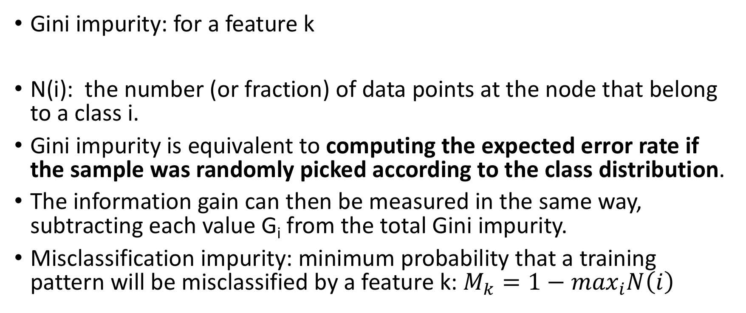
Classification and Regression Trees (CART)
Gini impurity: for a feature k
N(i): the number (or fraction) of data points at the node that belong to a class i.
Gini impurity is equivalent to computing the expected error rate if the sample was randomly picked according to the class distribution.
The information gain can then be measured in the same way, subtracting each value G_{i} from the total Gini impurity.
Misclassification impurity: minimum probability that a training pattern will be misclassified by a feature k: $M_{k}=1−\max_{i}N\left(i\right)$

Slide 12
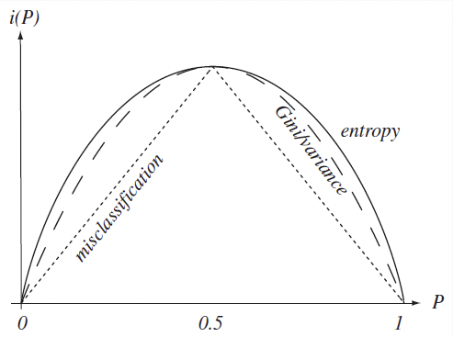

Slide 13
When to Stop Splitting?
If we continue to grow the tree fully until each leaf node corresponds to the lowest impurity, then the data have typically been overfit; in the limit, each leaf node has only one data point.
If splitting is stopped too early, error on training data is not sufficiently low and performance will suffer
Validation and cross-validation
Continue splitting until error on validation set is minimum
Cross-validation relies on several independently chosen subsets
Stop splitting when the best candidate split at a node reduces the impurity by less than the preset amount (threshold)
How to set the threshold? Stop when a node has small no. of points or some fixed percentage of total training set (say 5%)
Trade off between tree complexity or size vs. test set accuracy

Slide 14
Regression using CART
To evaluate the choice of which feature to use next, we evaluate a split by computing the mean average of all the data points in each leaf, and then evaluating the sum-of-squares error across all leaves.
We can pick the feature that has the split point that provides the best sum-of-squares error, and continue to use the algorithm as for classification.

